Slide 1
ITU-ML5G-PS-009: RF-Sensor Based Human Activity Recognition
RF-Sensor Based Human Activity Recognition Using Hierarchical Classifier
- Pedamalli Saikrishna
- Ashwini Kumar
- Ashok Kumar Reddy Chavva
- Sripada Kadambar
Beyond 5G Team
Samsung R&D Institute Bangalore

Slide 2
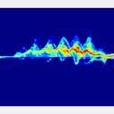
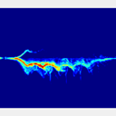
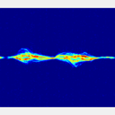
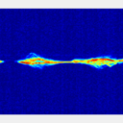
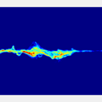
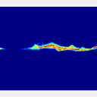
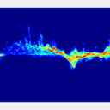
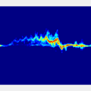
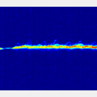
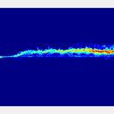
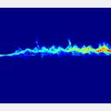
Problem Statement: Human Activity Recognition
RF sensing has application in various areas such as
Smart environments.
Intruder detection.
Remote Health Monitoring.
Fall detection.
Differentiate among 11 different activities.
Walking towards radar – class 0
Walking away from radar – class 1
Picking up an object – class 2
Bending – class 3
Sitting – class 4
Kneeling – class 5
Crawling – class 6
Walking on both toes – class 7
Limping with RL stiff – class 8
Short steps – class 9
Scissors gait – class 10
A few salient features of using RF sensors are
Effective under low/no light scenarios .
Low cost of RF Sensors.
Non-contact and non personally invasive.
Apply short time Fourier transform to obtain the micro-Doppler spectrogram (mDS).
Each human activity generates mDS with different patterns.
Here, we are expected to classify activities using the mDS using pattern recognition / ML / DL.

Slide 3
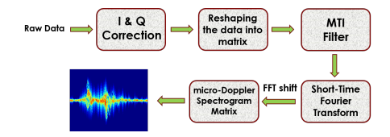
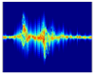
Literature Survey
In the literature, various RF based sensors (77 GHz FMCW, 24 GHz FMCW and Xethru) are used to determine the activity.
The most common approach employed in literature to achieve this is by converting the raw data into a micro-Doppler spectrogram image and treat the problem of activity recognition as a image classification problem.
The classification is then done by using CNN or CAE based architectures [1].
Pre-processing step – converting RF signal into image
CNN/CAE Based
Classifier
Recognition of the activity
Activity classification using Deep learning
[1] Sevgi. Z. Gurbuz et.al "Cross-frequency training with adversarial learning for radar micro-Doppler signature classification", Proc. SPIE 11408, Radar Sensor Technology XXIV, 114080A (11 May 2020)

Slide 4
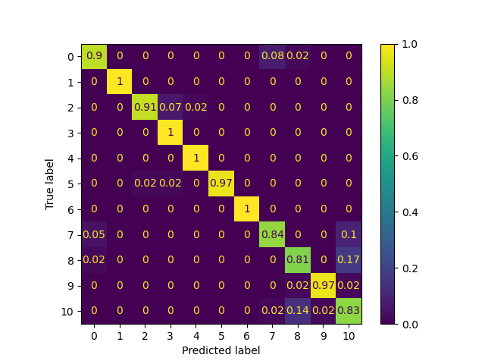
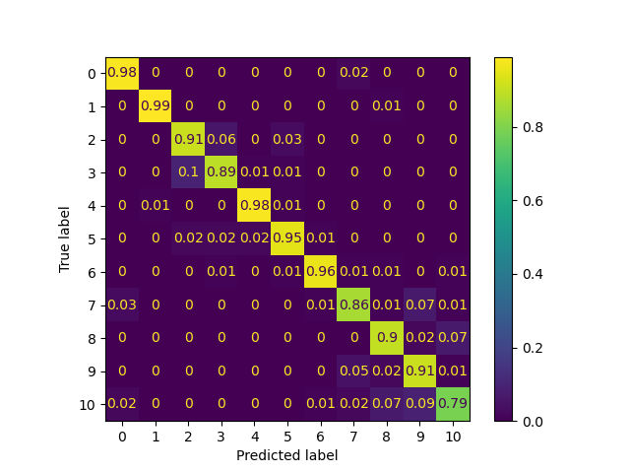
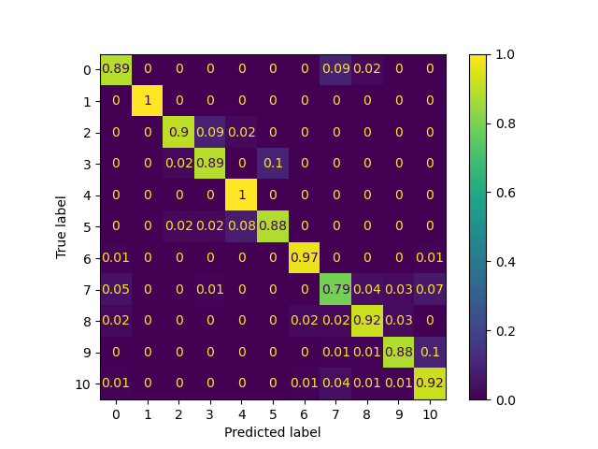
Motivation – Understanding the Drawbacks of Existing Literature
CNN – 77 GHz
CNN – 24 GHz
CNN – Xethru
Observed the following classes accuracy is lower
Picking up an object – class 2
Bending – class 3
Walking on both toes – class 7
Limping with RL stiff – class 8
Short steps – class 9
Scissors gait – class 10.
Misclassification higher in the following combinations
Classes 2 & 3
Classes 8, 9 & 10
Class 7 is spread across.

Slide 5
Motivation – Analysis of Spectrograms & Hierarchical Classification
Classes under inspection
Picking up an object – class 2
Bending – class 3
Walking on both toes – class 7
Limping with RL stiff – class 8
Short steps – class 9
Scissors gait – class 10
Feature Space 2
Feature Space 1
Feature Space 2
Observations
The spectrograms of classes 2 & 3 look very similar.
The spectrograms of classes 8, 9 & 10 look very similar.
Class 7 looks different from the remaining classes.
Multi-class classification.
Let each colour correspond to different class.
Different feature spaces – Confusion classes can be different.
Hierarchical classifiers – Exploit the separability of different combination of classes in different feature spaces.
[2] I. K. Sethi and G. P. R. Sarvarayudu, "Hierarchical Classifier Design Using Mutual Information," in IEEE Transactions on Pattern Analysis and Machine Intelligence, vol. PAMI-4, no. 4, pp. 441-445, July 1982

Slide 6
Proposed Solution – Hierarchical Classifier
Training
Similar classes merged together to form single class for all such instances.
Classes 2 and 3 (Bending and Picking up an object) are merged together
Classes 8, 9 and 10 (Limping, Short steps and Scissors gait) are merged together
First stage classifier – trained for 8 different classes after merging.
Second stage classifier
Trained to classify between 2/3.
Trained to classify between 8/9/10.
Start
Start
Pre-process to get Spectrograms
Pre-process to get Spectrogram
2 or more classes similar
Stage 1 Classifier
Output is non similar class
No
Yes
No
Corresponding Stage 2 Classifier
Merge them into single class
Train the stage 2 classifiers for all such scenarios
Yes
Train the stage 1 classifier
Use the first stage classifier to classify the spectrogram.
Resultant class – Non similar, Output class.
Else pass the spectrogram again through second stage classifier to obtain the Output class.
Output class
Stop
Stop
Stop
Hierarchical Classifier Training Flowchart
Hierarchical Classifier Deployment Flowchart

Slide 7
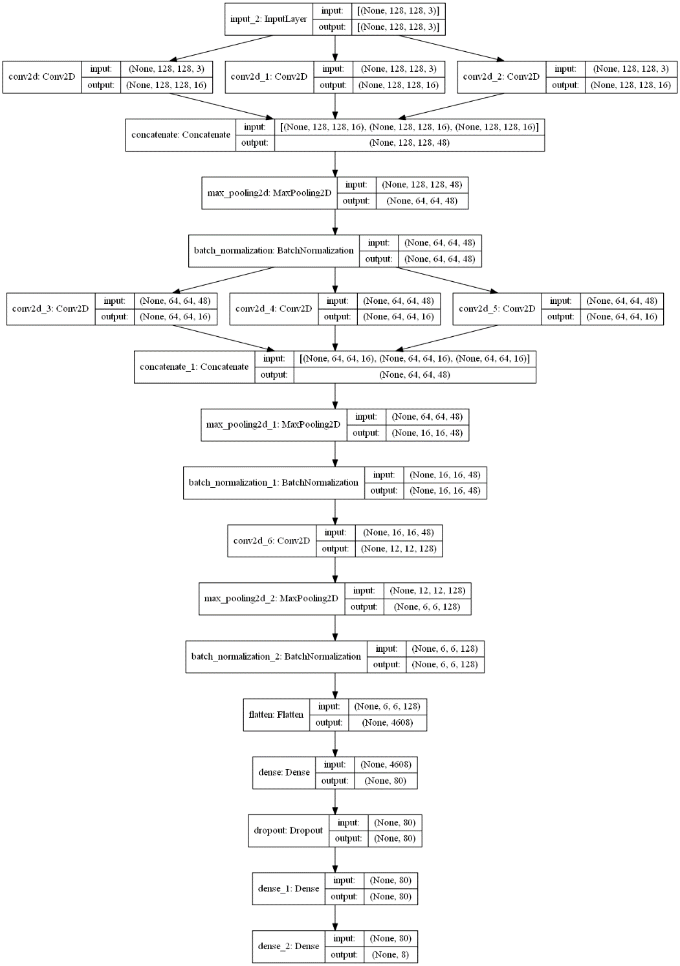
Proposed Solution – Network Architecture
First stage classifier – Six layer networks
Layer 1 – Inception layer
Followed by max pooling (2,2) and Batch normalization
Layer 2 – Inception layer
Followed by max pooling (4,4) and Batch normalization
Layer 3 – Convolutional layer, Kernel – 5*5, filters – 128
Followed by max pooling (2,2) and Batch normalization
Layer 4 – Dense layer – output nodes 80
Followed by Dropout (0.2)
Layer 5 – Dense layer – output nodes 80
Layer 6 – Output layer – output nodes 8.
Inception Layer – Different kernel sizes.
3 different kernels with 16 filters each
Kernel 1 – 3*11, Kernel 2 – 5*21, Kernel 3 – 9*9.
We used horizontal filters (height < width) as the gradient variations are more in that direction.
Inception Layers [3]
Convolutional Layer
Stage 2 classifiers differences compared to Stage 1
Instead of 16 filters we use 48 filters for each of the kernels in Inception layer.
The output nodes are either 2 or 3 instead of 8.
Fully Connected Layers
Output Layer
[3] C. Szegedy et al., "Going deeper with convolutions," 2015 IEEE CVPR, 2015

Slide 8
Results – Accuracy
Each network (Stage 1, Stage 2_1 (2/3) and Stage 2_2 (8/9/10)) are trained independently with 50 – 50 split.
The table provides the classification accuracy.
Entire data corresponds to (Training + Validation).
For the proposed solution we obtain validation accuracy conservatively by assuming training accuracy of 100%
Validation Accuracy = (2*Entire Dataset Accuracy) - 100.
Assumptions
Training accuracy = 100%.
Training – Validation is 50 – 50.
Hyper-parameters | Value
Optimizer | Adam
Batch size | 32
Epochs | 100
Loss function | Sparse categorical cross entropy
Sensor | Entire dataset Accuracy (%) |  |  | Validation Accuracy (%)
 | CNN | CAE | Hierarchical | CNN | CAE | Hierarchical
77 GHz | 93 | 92.9 | 95.67 | 86.11 | 85.8 | 91.34
24 GHz | 92.27 | 90.4 | 94.15 | 84.64 | 82.86 | 88.3
Xethru | 91.15 | 90.8 | 93.19 | 82.3 | 81.74 | 86.38
4 – 5 % improvement in validation accuracy

Slide 9
Results – Complexity
Architecture | Complexity (Giga FLOPs) | No. of Parameters
 |  | Trainable | Non-trainable | Total
CNN | ~8.577 | 3,261,235 | - | 3,261,235
CAE | ~17.152 | 3,247,243 | - | 3,247,243
Stage 1 | ~1.795 | 708,824 | 448 | 709,272
Stage 2_1 | ~13.648 | 2,382,674 | 832 | 2,383,506
Stage 2_2 | ~13.648 | 2,382,755 | 832 | 2,383,587
The combinations used in hierarchical classifier.
Stage 1,
Stage 1 followed by Stage 2_1 (2,3),
Stage 1 followed by Stage 2_2 (8,9,10),
To obtain the Average complexity, we assume one sample of each class and get the average.
6 samples require stage 1,
2 samples require (stage 1 + stage 2_1),
3 samples require (stage 1 + stage 2_2).
CNN (Giga FLOPs) | CAE (Giga FLOPs) | Hierarchical (Giga FLOPs)
 |  | Best case | Worst case | Average
~8.577 | ~17.152 | ~1.795 | ~15.443 | ~7.999

Slide 10
Conclusion and Future Work
Conclusion
Improvement of 4 – 5 % in validation accuracy for all sensors.
Requires only 21% compute of CNN and 10.5 % of CAE under best case scenario.
Average complexity is 93% of that of CNN and 46.6% of that of CAE.
Less prone to overfitting – less parameters, inclusion of Batch normalization and Dropout.
Future Work
Exploring Ensemble of different classification algorithms.
Hyper-parameter tuning for stage 2 classifier – optimizing complexity.
Exploiting the raw data instead of spectrogram images.

Slide 11
References
[1] Sevgi Z. Gurbuz, M. Mahbubur Rahman, Emre Kurtoglu, Trevor Macks, Francesco Fioranelli, "Cross-frequency training with adversarial learning for radar micro-Doppler signature classification (Rising Researcher)," Proc. SPIE 11408, Radar Sensor Technology XXIV, 114080A (11 May 2020); https://doi.org/10.1117/12.2559155
[2] I. K. Sethi and G. P. R. Sarvarayudu, "Hierarchical Classifier Design Using Mutual Information," in IEEE Transactions on Pattern Analysis and Machine Intelligence, vol. PAMI-4, no. 4, pp. 441-445, July 1982, doi: 10.1109/TPAMI.1982.4767278.
[3] C. Szegedy et al., "Going deeper with convolutions," 2015 IEEE Conference on Computer Vision and Pattern Recognition (CVPR), 2015, pp. 1-9, doi: 10.1109/CVPR.2015.7298594.

Slide 12
Appendix 1 – Validation Accuracy for Proposed Architecture
Entire Dataset Accuracy = (Percentage of Data for training * Training accuracy + Percentage of Data for validation * Validation accuracy)
Here, Percentage of Data for training = Percentage of Data for validation = 50% = 0.5
Entire Dataset Accuracy = (0.5 * Training accuracy + 0.5 * Validation accuracy)
For a given entire dataset accuracy (constant), the worst case validation accuracy is when training accuracy is highest (maximum possible = 100%).
Entire Dataset Accuracy = (0.5 * 100 + 0.5 * Validation accuracy)
Entire Dataset Accuracy = (50 + (0.5 * Validation accuracy))
Entire Dataset Accuracy - 50 = 0.5 * Validation accuracy
Validation accuracy = 2*(Entire Dataset Accuracy - 50)
Validation accuracy = (2*Entire Dataset Accuracy) - 100.

Slide 13
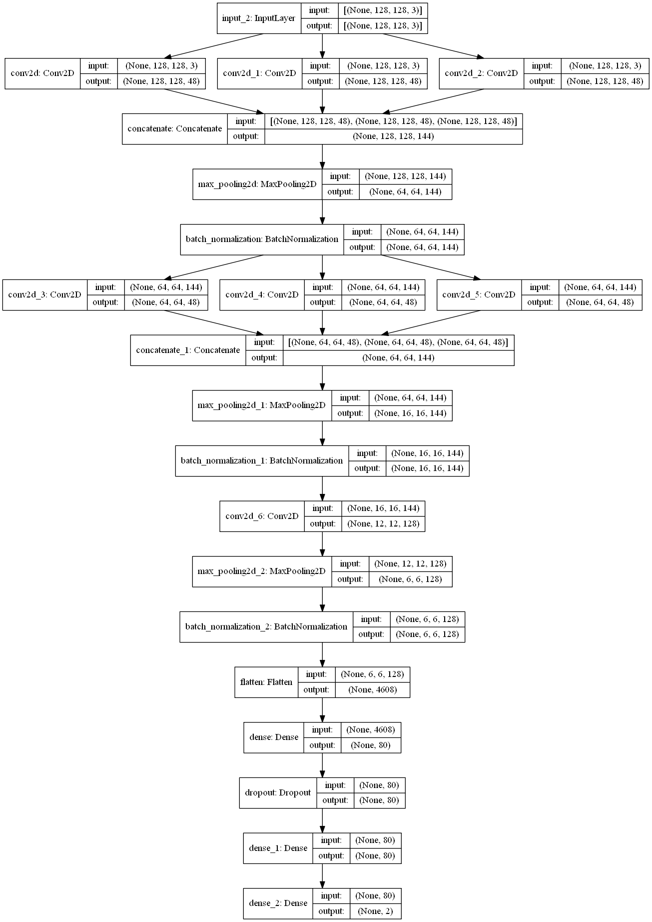

Appendix 2 – Stage 2 Classifiers

Slide 14
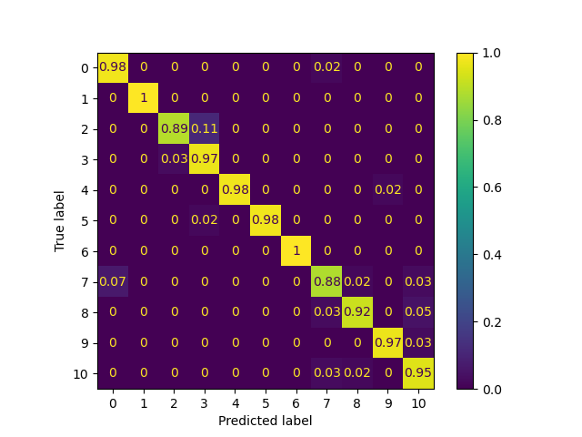
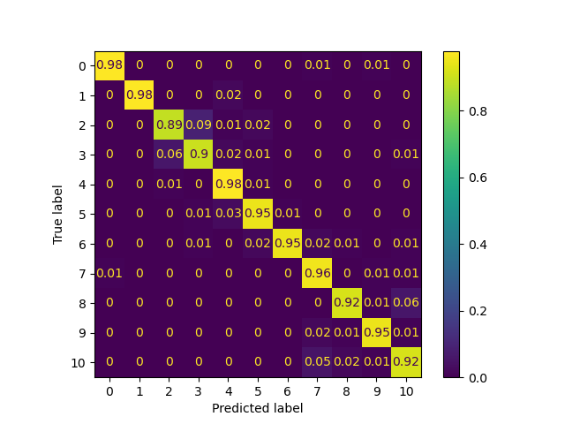

Appendix 3 – Comparison of Confusion Matrices (Complete Dataset)
Confusion Matrix – proposed – 77 GHz
Confusion Matrix – proposed – 24 GHz
Confusion Matrix – proposed – Xethru
Confusion Matrix – CNN – 77 GHz
Confusion Matrix – CNN – 24 GHz
Confusion Matrix – CNN – Xethru

Slide 15
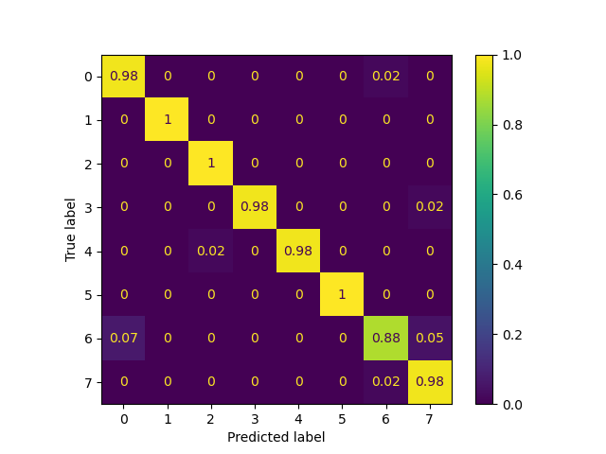
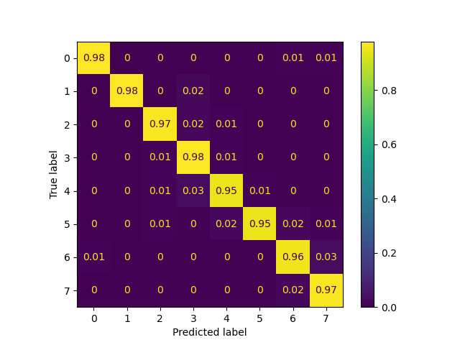
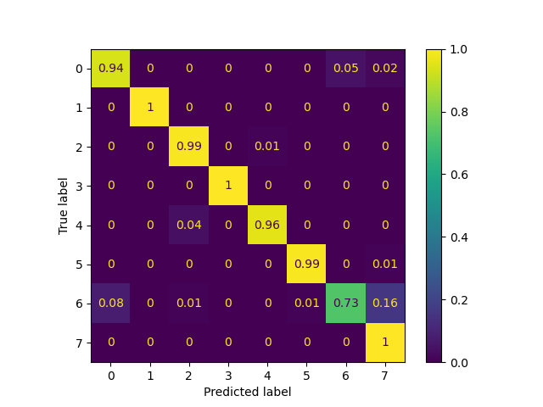
Appendix 3 – Comparison of Confusion Matrices (Stage 1 – Proposed)
Confusion Matrix – 77 GHz
Confusion Matrix – 24 GHz
Confusion Matrix – Xethru
Sensor | Validation Accuracy (%)
77 GHz | 95.68
24 GHz | 94.04
Xethru | 92.1

Slide 16
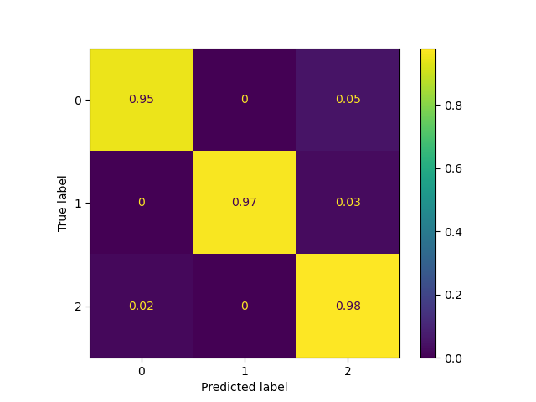
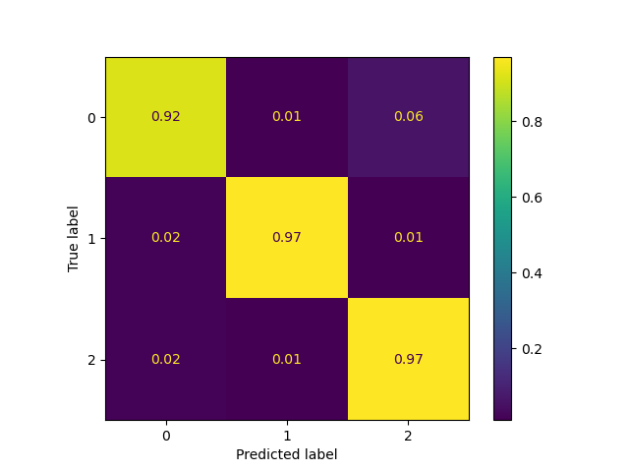
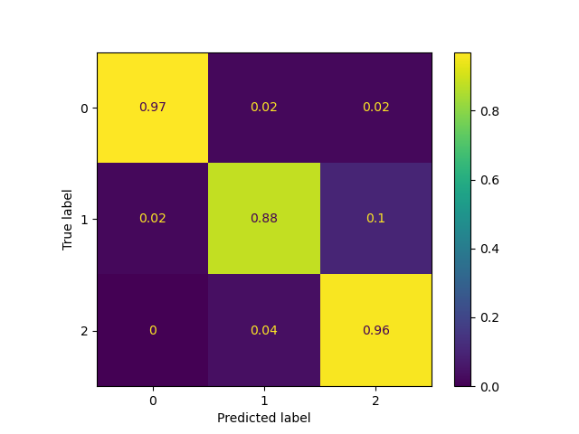
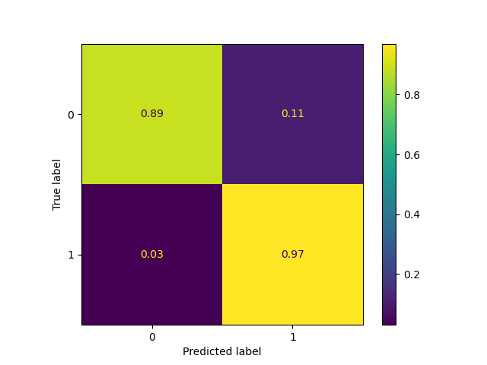
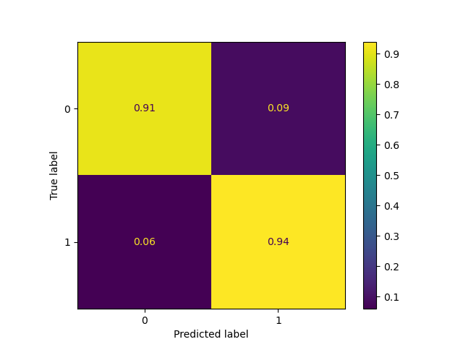
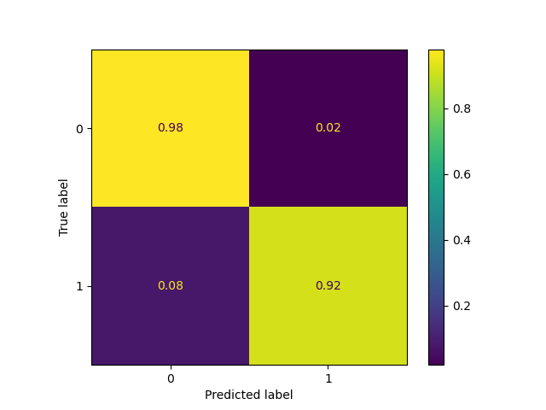
Appendix 3 – Comparison of Confusion Matrices (Stage 2 – Proposed)
Confusion Matrix – 77 GHz
Confusion Matrix – 24 GHz
Confusion Matrix – Xethru
Sensor | Validation Accuracy (%)
 | Stage 2_1 | Stage 2_2
77 GHz | 85.96 | 93.26
24 GHz | 84.9 | 90.79
Xethru | 90 | 86.84

Slide 17
Appendix 4 – Mix and Match for Multimodal
Confusion Matrix – Stage 2_1 – 77 GHz
Confusion Matrix – Stage 2_1 – Xethru
Confusion Matrix – 11 Classes – 77 GHz
Ideally, in the presence of multi modal, we would have trained each network using all the sensor data by
By concatenating at input layer
Or after Inception layers
Or after Convolutional layers
But, due to the non conducive nature of the data
Non availability of data of the activity across sensors in the same time instance or interval of time.
By having 77 GHz – Stage 1, Xethru – Stage 2_1 and 77 GHz – Stage 2_2
Overall accuracy – 96% from 95.6% using 77 GHz alone.
Complexity remains same as using the single sensor.
This will then result in Validation accuracy of 92%.

